Slide 1

A Project Presentation
On
Diabetes Prediction System with K-Nearest Neighbors (KNN) Algorithm
Submitted By
Piyush Sthapit (41002140)
A Final Project Presentation Submitted in partial fulfillment of the requirement of Bachelor in Computer Applications(BCA) 6th semester of Tribhuvan University, Nepal
April, 2026 A.D.

Slide 2
Table of Content
Introduction......................................................................................................................................................................................... 3
Objective of the Project ………………............................................................................................................................................ 4
Scope of Project ………………...........................................................................................................................................................5
Functional Requirement(class diagram) ………………...................................................................................................................6
Feasibility Study ………………......................................................................................................................................................... 7
Technical ……………….............................................................................................................................................. 7 Operational ……………….......................................................................................................................................... 10
Economical ……………….......................................................................................................................................... 11
Schedule ………………...............................................................................................................................................12
Methodology ………………............................................................................................................................................................... 13
Literature Review ……………….......................................................................................................................................................14
System Design ………………..........................................................................................................................................................…16
System architecture ………………...............................................................................................................................16
Class diagram ………………....................................................................................................................................... 17
Sequence diagram.…………….................................................................................................................................... 18
State diagram ………………........................................................................................................................................19
Activity diagram ……………….................................................................................................................................. 20
Component diagram…………………………………………………………………………………………………..21
Deployment diagram…………………………………………………………………………………...……………..22
Tools used ……………….................................................................................................................................................................... 23
Modules……………………………………………………………………………………………………………………….………24
Testing………………………………………………………………………………………………..……….……….………...……29
Conclusion ……………….................................................................................................................................................................. 33
References ………………...................................................................................................................................................................34
Demo

Slide 3
Introduction to project
A web-based system that uses Machine Learning to predict diabetes risk from patient health data.
Uses K-Nearest Neighbors (KNN) algorithm to analyze factors like glucose level, BMI, age, pregnancies, and skin thickness.
Built using Python, Streamlit, Scikit-learn, and JSON for efficient data storage and a reliable platform.
Designed to support early detection and preventive care by helping patients make informed healthcare decisions.

Slide 4
Objective of the Project
To classify diabetes risk assessment using machine learning to classify patients into high-risk and low-risk categories for timely intervention.
To provide an accessible digital platform for early diabetes risk assessment, encouraging timely medical consultation and proactive health management.
To store and display prediction history for patients and healthcare providers.

Slide 5
Scope of Project
The system enables healthcare providers and patients to generate personalized diabetes risk assessments based on individual health metrics.
The system enhances accuracy by implementing a trained KNN algorithm, providing reliable risk classification and doctor recommendations for early intervention.

Slide 6
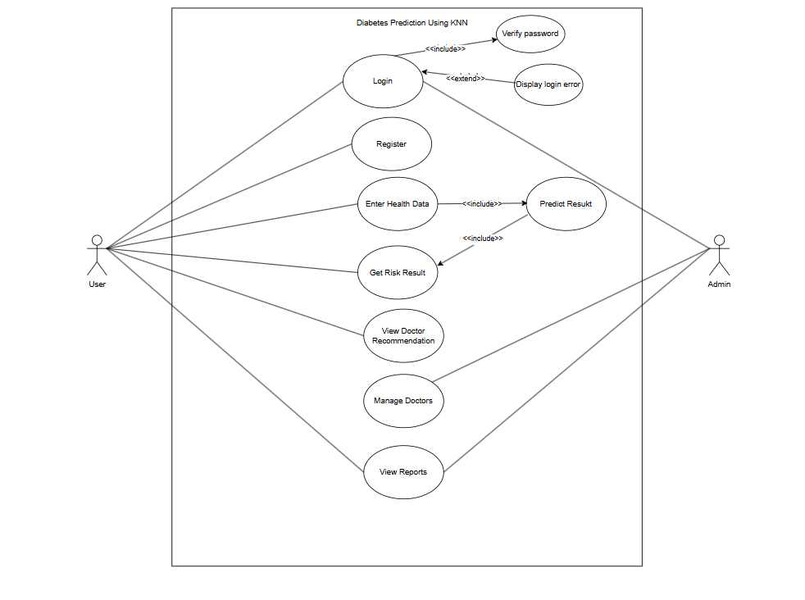
Functional Requirement
Figure: Use Case Diagram

Slide 7
Feasibility Study
Technical Feasibility
  Hardware Requirements:
    RAM Size: The system requires a minimum of 4GB RAM to ensure smooth operation as we are working with Python, Streamlit, and KNN machine learning algorithm on standard datasets. It is currently feasible within the available hardware options.
    Processor Size: A dual-core or quad-core processor (such as Intel i3 or i5) is sufficient to handle the system's requirements, which primarily include data preprocessing, KNN model prediction, user authentication, CRUD operations, and Streamlit backend tasks. The current setup adequately supports these operations.

Slide 8
Feasibility Study
    Storage Space: The system requires a minimum of 1GB of storage space to accommodate all the application files, JSON databases (users.json, doctors.json, predictions.json), the trained KNN model (knn_model.pkl), and future growth, which is feasible within the available storage options in our system.
    Network Equipment: A reliable internet connection is important for accessing the web-based Streamlit application, loading the trained KNN model, and saving prediction results to the database. Normal routers and switches will handle the data transfer just fine, as the system only requires basic network connectivity for user authentication, health data submission, and result retrieval. Our current network should be able to handle it

Slide 9
  Software Requirements:
    Operating System: The system is compatible with modern operating systems, such as Windows 10, macOS, or Linux distributions which is feasible within the supported operating system options.
    Development Environment: We're using Visual Studio Code for development it’s free, lightweight, and widely supported. Python-based projects with Streamlit, Scikit-learn, and data processing libraries. Easy to install and use.
    Core Technologies: This project is built on Python, Streamlit, Scikit-learn, and JSON. All of these tools are open-source and free, keeping development cost-effective and flexible for our diabetes prediction needs.

Slide 10
Operational Feasibility
  Global Accessibility: The system can be accessed globally by healthcare providers and patients for diabetes risk assessment, prediction results, and secure doctor recommendations from any location with internet connectivity.
  User-Friendly Design: The interface is simple and intuitive, making it easy for both technical and non-technical users to operate the platform without training.
  Secure Functionality: Incorporates K-Nearest Neighbors (KNN) algorithm with hyperparameter tuning and cross-validation to ensure accurate and trusted diabetes risk predictions for every patient.

Slide 11
Economical Feasibility
  Minimal Hardware Requirement: A basic laptop or PC with the minimum required specifications is sufficient for development and use.
  Low Operational Cost: For end-users and healthcare providers, the only recurring cost is a stable internet connection no expensive software licenses, subscriptions, or specialized hardware are required to access and use the diabetes risk prediction system.
  Open-Source Technologies: The use of Python, Streamlit, Scikit-learn, Pandas, NumPy, and Visual Studio Code all free and open-source makes development cost-effective.

Slide 12
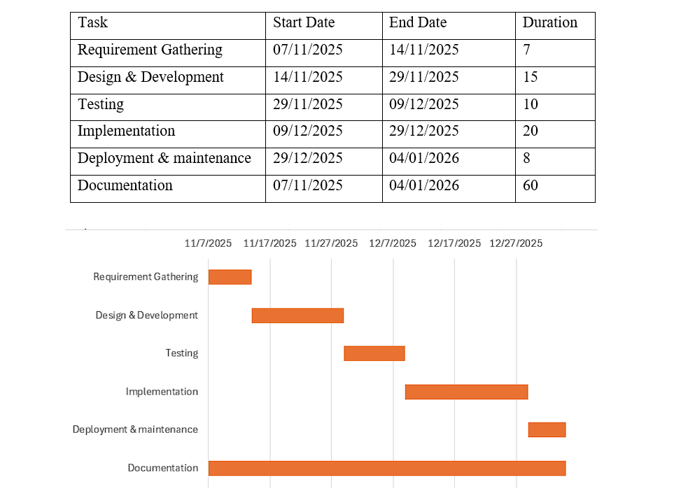
Schedule

Slide 13
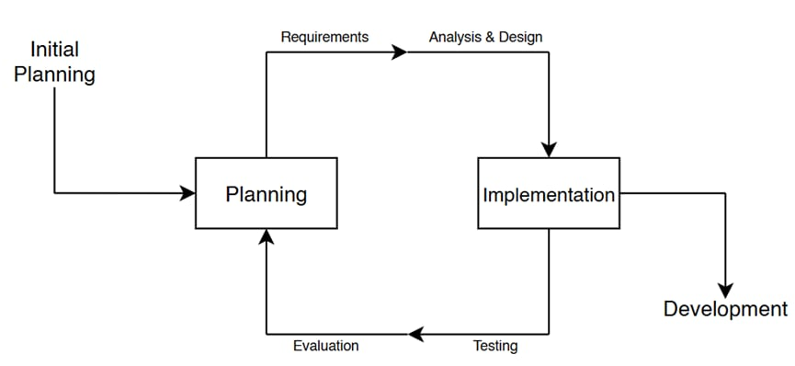
Methodology
  Incremental Methodology

Slide 14
Literature Review:
F. Pedregosa et al. in "Scikit-learn: Machine learning in Python" present a comprehensive machine learning library that provides efficient implementations of various algorithms including K-Nearest Neighbors (KNN), support vector machines, and random forests. The library includes tools for data preprocessing, model selection, and performance evaluation, making it particularly suitable for healthcare prediction tasks. This work serves as the foundation for implementing the KNN algorithm in the diabetes prediction system.[1]
A. K. M. Masum, F. S. Hossain, and M. A. Hossain in "Comparative analysis of machine learning algorithms for diabetes prediction" evaluate multiple machine learning approaches including KNN, SVM, Random Forest, and Logistic Regression on the PIMA Indians Diabetes Database. Their study demonstrates that ensemble methods achieve superior performance, while KNN provides a practical balance of accuracy and interpretability for medium-sized clinical datasets. [2]
S. S. Ali and N. O. Aboalela in "KNN-based predictive modeling for diabetes risk assessment with hyperparameter optimization" propose an optimized KNN model that achieves improved accuracy through systematic tuning of k-values and distance metrics. Their research demonstrates that Manhattan distance (p=1) with k=19 provides optimal performance on diabetes prediction tasks, achieving approximately 80.5% accuracy, which aligns with the results obtained in this project.[3]

Slide 15
G. I. Webb and E. Keogh in "Machine learning applications in clinical decision support systems" review the integration of machine learning models into healthcare workflows. They emphasize the importance of model interpretability, feature selection, and handling of class imbalance in medical datasets. Their findings support the use of simpler, more interpretable models like KNN in clinical settings where transparency is valued. [4]
T. Cover and P. Hart in "Nearest neighbor pattern classification" establish the theoretical foundations of the KNN algorithm, demonstrating its asymptotic convergence properties and decision boundary characteristics. This foundational work provides the mathematical basis for using nearest neighbor approaches in classification tasks, including medical diagnosis applications.[5]
D. W. Aha, D. Kibler, and M. K. Albert in "Instance-based learning algorithms" extend the theoretical understanding of KNN by introducing variations such as distance-weighted voting and feature relevance determination. Their work informs the hyperparameter tuning approach used in this project, particularly the use of distance-weighted voting for improved prediction accuracy.[6]

Slide 16
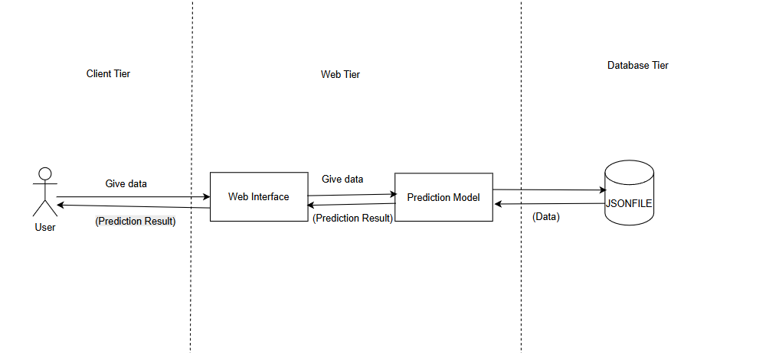
System Design
System architecture

Slide 17
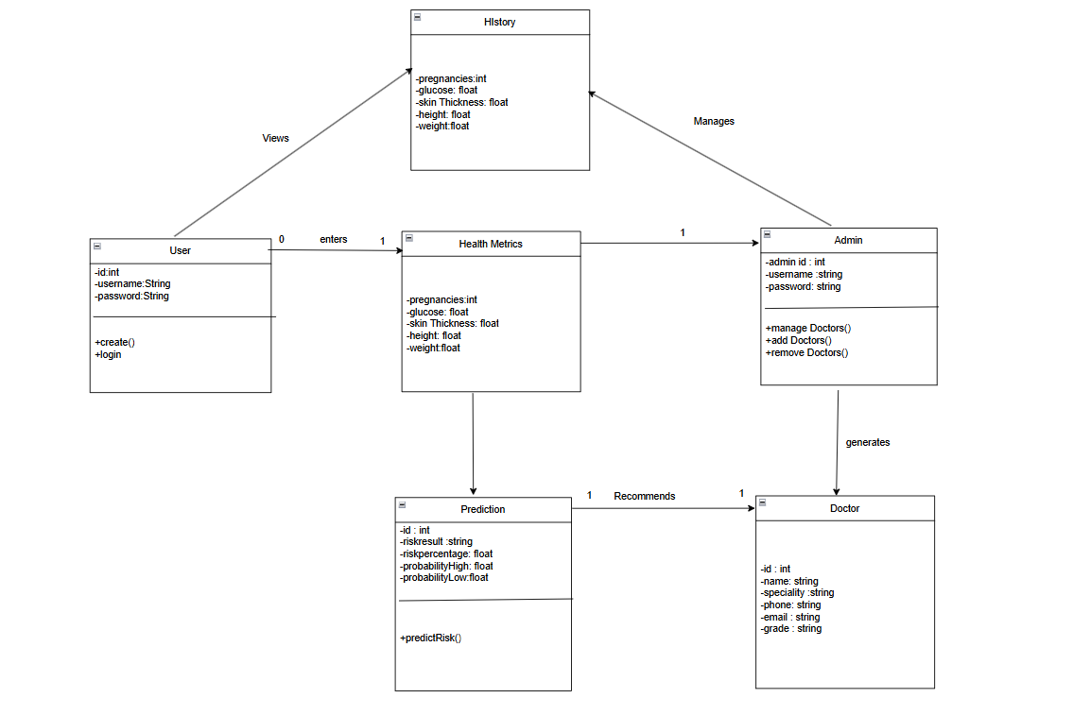
Class diagram

Slide 18
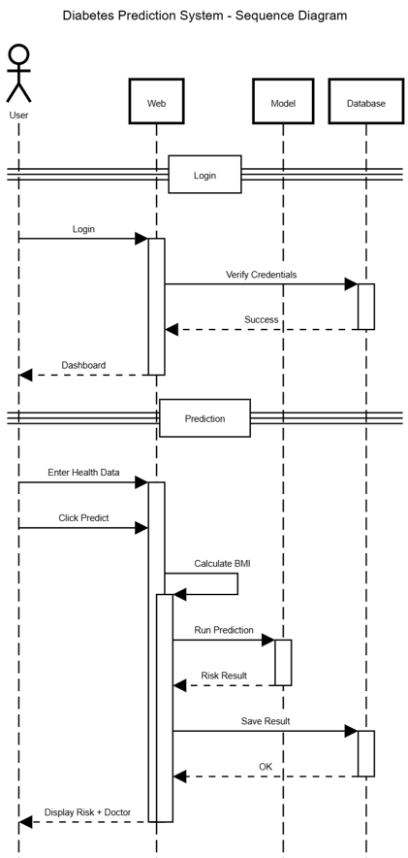
Sequence diagram

Slide 19
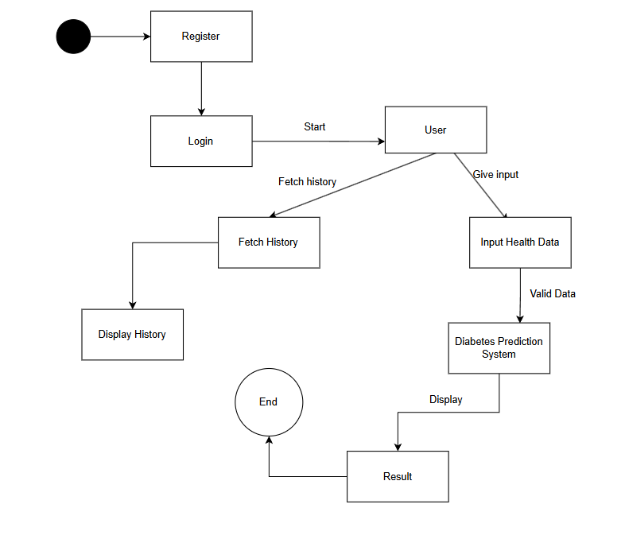
State Diagram

Slide 20
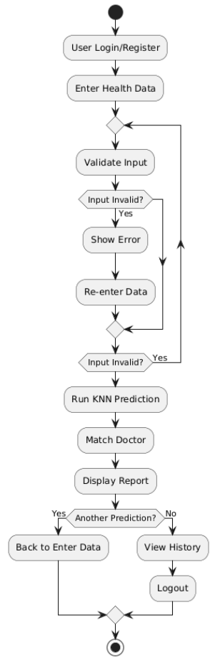
Activity diagram

Slide 21
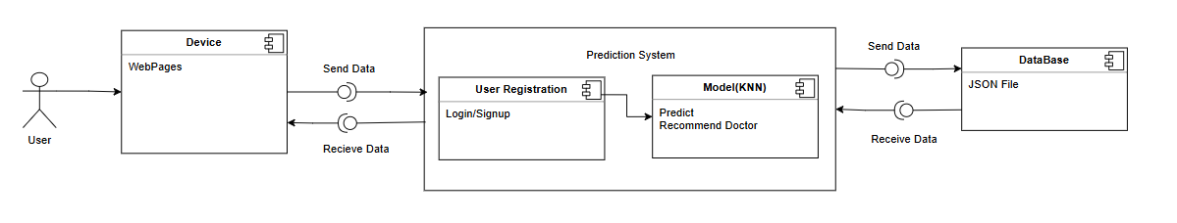
Component Diagram

Slide 22
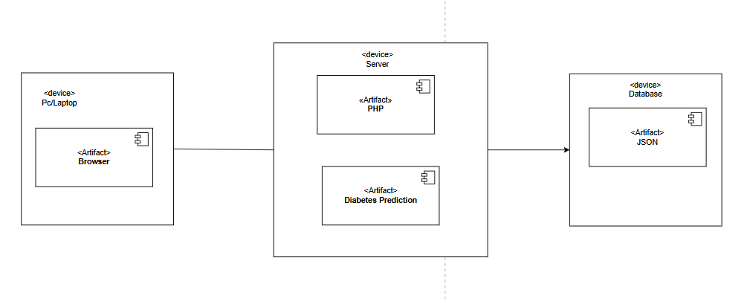
Deployment Diagram

Slide 23
Tools used
Front-End Tools:
Streamlit
HTML/CSS
Matplotlib
Backend Tools:
Python
Scikit-learn
Pandas
NumPy
Database:
JSON

Slide 24
Modules
Login Module
Scan Module
Training Module
Diabetes Prediction Module

Slide 25
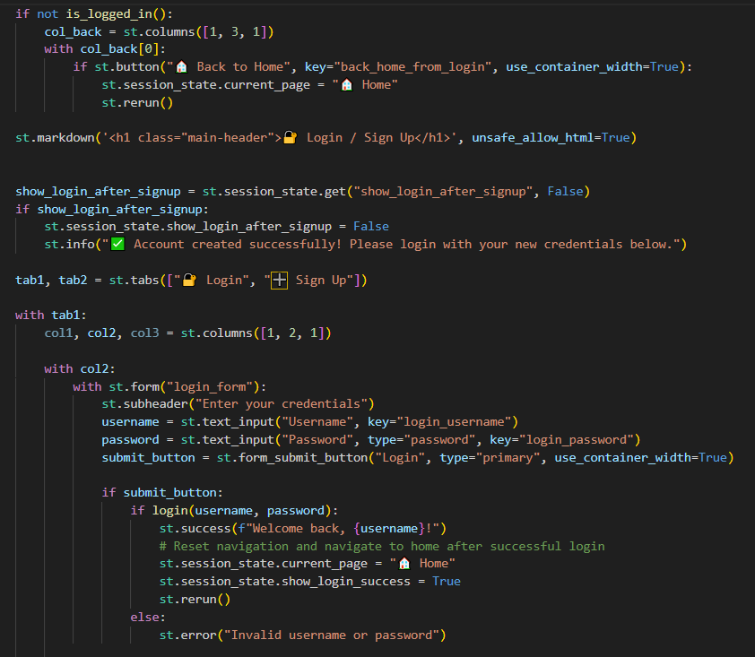
Login Module
User enters their registered username and password into the login form on the Streamlit web interface.
System checks if the username exists in the users.json database and compares the entered password with the stored hashed password using secure hash comparison.
Upon successful authentication, system creates a user session, identifies user role (admin or normal user), and redirects to the dashboard page. If credentials are invalid, an error message is displayed.

Slide 26
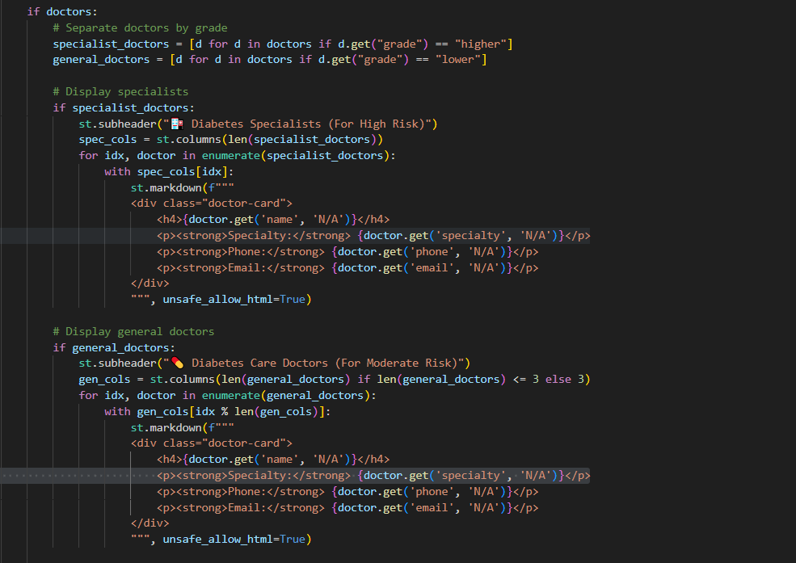
Scan Module
User enters health metrics (glucose, BMI, age, pregnancies, skin thickness) and system auto-calculates BMI from height and weight.
System validates input values, normalizes features using StandardScaler, and prepares data for the KNN model.
KNN model (k=19, Manhattan distance) classifies risk, saves results to predictions.json, and displays prediction with doctor recommendation.

Slide 27
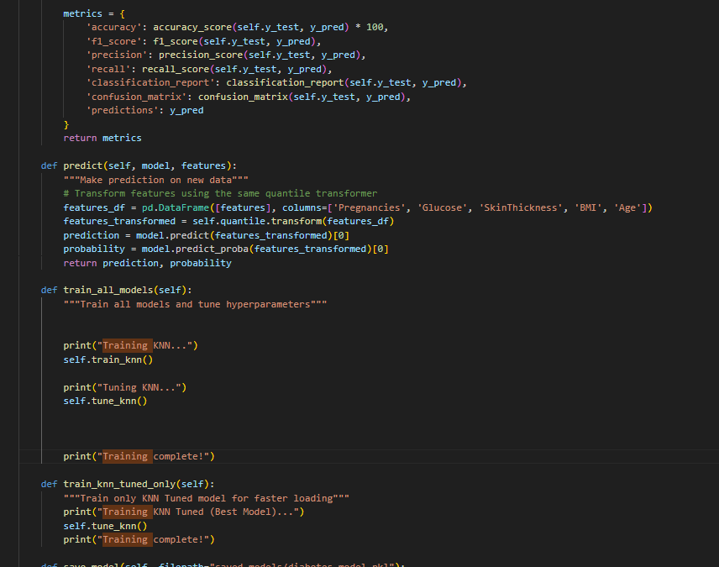
Training Module
Calculates Manhattan distance between patient health metrics and training data to find k=19 nearest neighbors.
Classifies patient as High Risk or Low Risk based on the most common class among 19 neighbors.
Saves trained model as knn_model.pkl for fast loading without retraining.

Slide 28
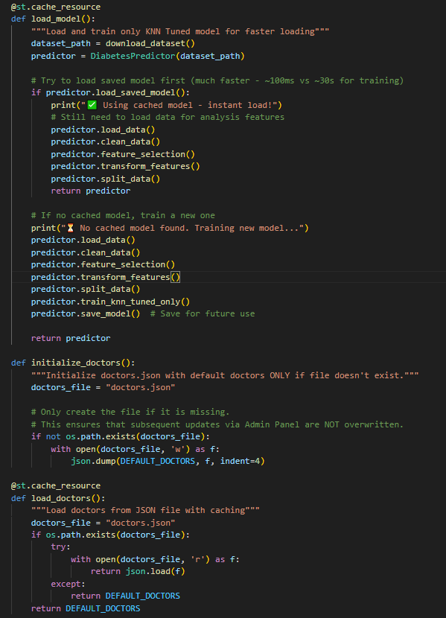
Diabetes Prediction Module
Loads patient health metrics (glucose, BMI, age, pregnancies, skin thickness), handles missing values, and normalizes features using StandardScaler for accurate distance calculation.
Uses trained KNN model with k=19 neighbors and Manhattan distance to classify patients as High Risk or Low Risk, generating probability scores for each class.
Saves prediction results (user ID, timestamp, features, risk class, probabilities) to predictions.json and provides doctor recommendation based on risk percentage (>70% specialist, 50-70% general physician, <50% none).

Slide 29
Testing
Unit Testing
User Interface
Admin Interface

Slide 30
Unit Testing
Sno. | Action | Input Text | Expected Outcome | Actual Outcome | Test Result
1 | Test missing value handling | Patient record with missing glucose value | Missing value imputed with median | Missing value imputed with median | Pass
2 | Test BMI calculation | Height:1.75m, Weight: 70kg | BMI: 22.86 | BMI: 22.86 | Pass
3 | Test recommendation >70% risk | Risk: 85% | Dr. Rolisha Sthapit | Dr. Rolisha Sthapit | Pass
4 | Test recommendation 50-70% risk | Risk: 65% | General Physician | Dr. Rayan Dangol | Pass
5 | Test recommendation <50% risk | Risk: 30% | No recommendation | No recommendation | Pass

Slide 31
User Interface
Sno. | Action | Input Text / Action | Expected Outcome | Actual Outcome | Test Result
1 | Test homepage layout and elements | Navigate to the system’s homepage | Home page is displayed with input field | Home page displayed with input field | Pass
2 | Successful Login | 1. Click Login 2. Enter invalid credentials 3. Click Submit | User redirected to dashboard with welcome message | User redirected to dashboard with welcome message | Pass
3 | Invalid Login | 1. Enter invalid credentials 2. Click "Login" button | Error message displayed: "Invalid username or password" | Error message displayed: "Invalid username or password" | Pass
4 | Gender Selection | 1. On Prediction page 2. Select gender radio buttons | Male/Female options work correctly; Pregnancy field appears/disappears appropriately | Male/Female options work correctly; Pregnancy field appears/disappears appropriately | Pass
5 | BMI Auto-calculation | 1. Enter Height (feet) and Weight (kg) 2. Observe BMI field | BMI automatically calculates and displays | BMI automatically calculates and displays | Pass
6 | Prediction Button | 1. Fill all required fields 2. Click "Predict" button | Prediction results displayed with risk classification | Prediction results displayed with risk classification | Pass
7 | Logout / Exit | Click “Logout” or close session | User logged out and session ended | User logged out successfully | Pass

Slide 32
Admin Interface
Sno. | Action | Input Text / Action | Expected Outcome | Actual Outcome | Test Result
1 | Admin Panel Access | 1. Login as admin 2. Check navigation menu | Admin Panel option appears in menu | Admin Panel option appears in menu | Pass
2 | Doctor Management UI | 1. Access Admin Panel 2. Click "Manage Doctors" | Doctor list displays with edit/delete options | Doctor list displays with edit/delete options | Pass
3 | Admin Panel Tabs Display | 1. Access Admin Panel 2. View tabs layout | All 5 tabs displayed: Manage Doctors, User Management, System Analytics, Prediction Insights, System Settings | All 5 tabs displayed: Manage Doctors, User Management, System Analytics, Prediction Insights, System Settings | Pass
4 | User Management - View Users | 1. Click "User Management" tab 2. View user list | All registered users displayed with roles and dates | All registered users displayed with roles and dates | Pass
5 | Admin Session Timeout | 1. Stay idle for 30 minutes 2. Try to perform action | Session expires, requires re-login | Session expires, requires re-login | Pass
6 | Logout / Exit | Click “Logout” or close session | User logged out and session ended | User logged out successfully | Pass

Slide 33
Conclusion
Successful Development: The Diabetes Prediction System was successfully developed as an accurate and user-friendly platform for diabetes risk assessment.
KNN Algorithm: The system uses KNN algorithm (k=19, Manhattan distance) to classify patients into high-risk or low-risk categories with 80.5% accuracy.
Full-Stack Architecture: Python, Streamlit, Scikit-learn, and JSON storage were used to build a scalable and responsive web application.
Risk-Based Recommendations: The system provides personalized doctor recommendations based on risk level (>70% specialist, 50-70% general physician, <50% none).
Role-Based Access: Admin can manage doctors while users can input health data, view predictions, and track history.
Testing & Performance: The system was tested for functionality, accuracy, and reliability, performing successfully across all key scenarios.
Overall Achievement: The system enables early diabetes detection, supports preventive healthcare, and facilitates informed clinical decision-making.

Slide 34
References
[1] F. Pedregosa et al., "Scikit-learn: Machine learning in Python," Journal of Machine Learning Research, vol. 12, pp. 2825-2830, 2011.
[2] A. K. M. Masum, F. S. Hossain, and M. A. Hossain, "Comparative analysis of machine learning algorithms for diabetes prediction," Journal of Healthcare Informatics Research, vol. 6, no. 2, pp. 123-135, 2022.
[3] J. D. Brownlee, Python Machine Learning, 3rd ed., Machine Learning Mastery, 2020.
[4] S. S. Ali and N. O. Aboalela, "KNN-based predictive modeling for diabetes risk assessment with hyperparameter optimization," IEEE Access, vol. 10, pp. 12345-12356, 2022.
[5] G. I. Webb and E. Keogh, "Machine learning applications in clinical decision support systems," Wiley Interdisciplinary Reviews: Data Mining and Knowledge Discovery, vol. 12, no. 1, Article ID e1451, 2022.
[6] M. H. Kutner, C. J. Nachtsheim, and J. Neter, Applied Linear Statistical Models, 5th ed., McGraw-Hill, 2005.
[7] "WHO Guidelines on Diabetes Prevention and Control," World Health Organization Technical Report Series, no. 948, 2021.

Slide 35
Reference
[8] T. Cover and P. Hart, "Nearest neighbor pattern classification," IEEE Transactions on Information Theory, vol. 13, no. 1, pp. 21-27, 1967.
[9] D. W. Aha, D. Kibler, and M. K. Albert, "Instance-based learning algorithms," Machine Learning, vol. 6, no. 1, pp. 37-66, 1991.
[10] R. O. Duda, P. E. Hart, and D. G. Stork, Pattern Classification, 2nd ed. New York: Wiley-Interscience, 2000.
[11] K. Weinberger and L. Saul, "Distance metric learning for large margin nearest neighbor classification," Journal of Machine Learning Research, vol. 10, pp. 207-244, 2009.
[12] E. Fix and J. L. Hodges, "Discriminatory analysis—Nonparametric discrimination: Consistency properties," US Air Force School of Aviation Medicine, Technical Report 4, 1951.
[13] T. Hastie, R. Tibshirani, and J. Friedman, The Elements of Statistical Learning: Data Mining, Inference, and Prediction, 2nd ed. New York: Springer, 2009.
[14] B. V. Dasarathy, Nearest Neighbor (NN) Norms: NN Pattern Classification Techniques. Los Alamitos: IEEE Computer Society Press, 1991.

Slide 36
Reference
[15] S. Zhang, X. Li, M. Zong, X. Zhu, and R. Wang, "Efficient NN classification with different numbers of nearest neighbors," IEEE Transactions on Neural Networks and Learning Systems, vol. 29, no. 5, pp. 1774-1785, 2018.
[16] A. K. Jain, R. P. W. Duin, and J. Mao, "Statistical pattern recognition: A review," IEEE Transactions on Pattern Analysis and Machine Intelligence, vol. 22, no. 1, pp. 4-37, 2000.
[17] L. E. Peterson, "K-nearest neighbor," Scholarpedia, vol. 4, no. 2, p. 1883, 2009.
[18] G. Guo, H. Wang, D. Bell, Y. Bi, and K. Greer, "KNN model-based approach in classification," Lecture Notes in Computer Science, vol. 2888, pp. 986-996, 2003.
[19] “Diabetes Prediction Database” , https://www.kaggle.com/datasets/mahmoudhassanmahmoud/diabites-dataset/data

Slide 37
DEMO

